Slide 1
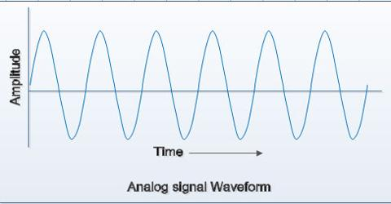
Introduction to Analog Transmission
An analog wave form (or signal) is characterized by being continuously variable along amplitude and frequency.

Slide 2
ANALOG TRANSMISSION
Advantages
Disadvantages
Easier in processing
Best suited for audio and video transmission.
Not necessary to buy a new graphics board.
Uses less bandwidth than digital sounds
Provide more accurate representation of a sound
It is the natural form of a sound
Analog tends to have a lower quality signal than digital.
The cables are sensitive to external influences.
Low availability of models with digital interfaces.
Recording analog sound on tape is quite expensive if the tape is damaged
It offers limitations in editing

Slide 3
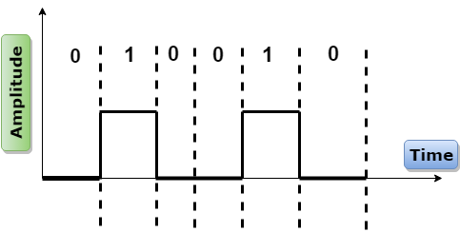
Introduction to Digital Transmission
It is a series of discrete pulses, representing one bits and zero bits.

Slide 4
CONCEPT TO BASEBAND AND BROADBAND
Baseband transmission and broadband transmission are two methods of transferring data between devices. And both two define how the data will transfer from one node to another. But both transmission devices are different from each other and use a different methods to supply the data.

Slide 5
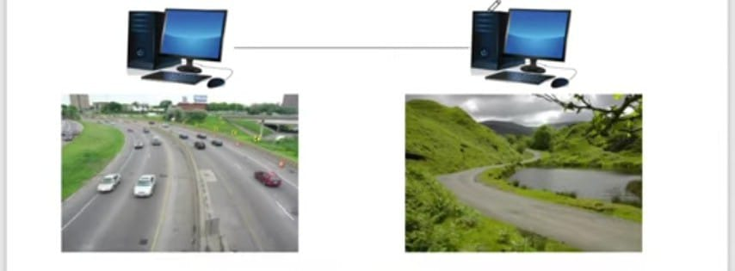
REAL LIFE EXAMPLES
BROADBAND
BASEBAND

Slide 6
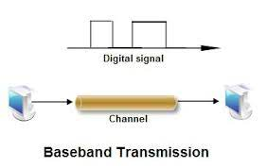
INTRODUCTION TO BASEBAND
Putting the original voice, video, or digital signals directly in the medium is referred to as bus band Binary data generated by a keyboard attached to a computer Computer data that is transmitted on cables peripherals such as o printer or so other computers over LAN Regardless of whether the original information/Baseband Transmission signals are log org, they are all f baseband signals The digital signal need in baseband transmission occupies the entire bandwidth of the network media to transmit a single data signal

Slide 7
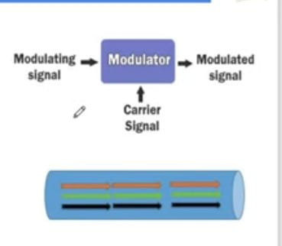
INTRODUCTION TO BROADBAND
Putting the modulated voice, video, or digital signals in the medium is referred to as broadband transmission. This technology uses a special analog wave known as the carrier wave. A carrier wove does not contain any data but contains all properties of the analog signal. This technology mises data/digital signal/binary values into the carrier wave and sends the carrier wave across the channel/medium.

Slide 8
COMPARISION
BASEBAND
BROADBAND
Signal use full bandwidth.
Signal travel a short distance.
Setup and Maintenance cost is low.
Baseband technology is mainly used in Ethernet networks to exchange data between nodes. This technology can be used on all three popular cable media types of Ethernet; coaxial, twisted-pair, fiber-optic.
Baseband supports bidirectional communication. It means, this technology can send and receive data simultaneously. To support bidirectional communication, this technology uses two separate electric circuits together; one for sending and another for receiving.
Multiple signals use media bandwidth.
Signal travel long distance.
Setup and maintenance cost is high.
Broadband is typically used in an environment that transmits audio, video, and data simultaneously. For example, Cable TV Networks, Radio stations, and Telephone companies. Usually radio waves, coaxial, fiber-optic cables are used for broadband transmission.
Broadband supports only unidirectional communication. It means, nodes connected at both ends of a medium can send or receive data but can't perform both actions simultaneously. Only one action is allowed at a time.

